Slide 1
Myo-Project Aircraft Game made with unity3D
BY Zang Wenxuan

Slide 2

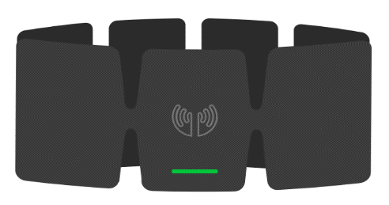


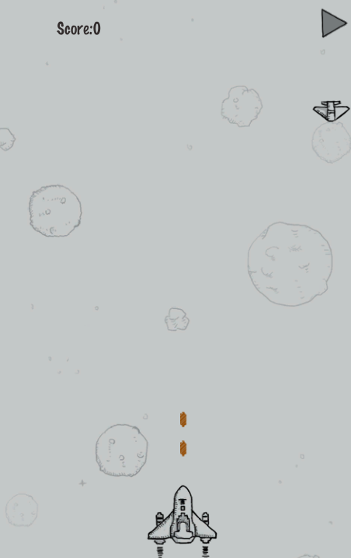
Architecture

Slide 3
Gesture control
Pose.WaveOut - (Move to the right)
Pose.WaveIn - (Move to the left)
Pose.DoubleTap -(pause game)
Pose.FingerSpread- (use bomb)
Pose.Fist- (restart game)

Slide 4
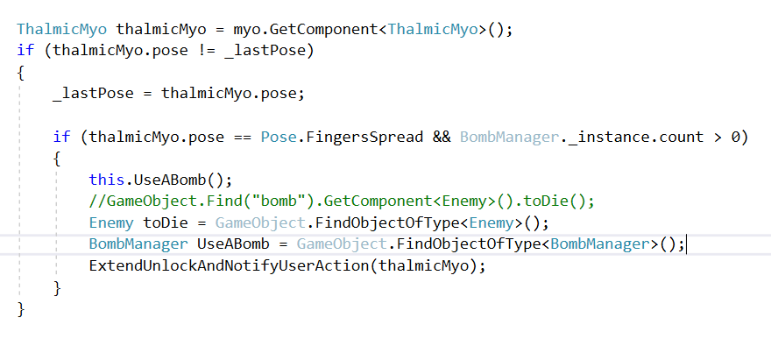
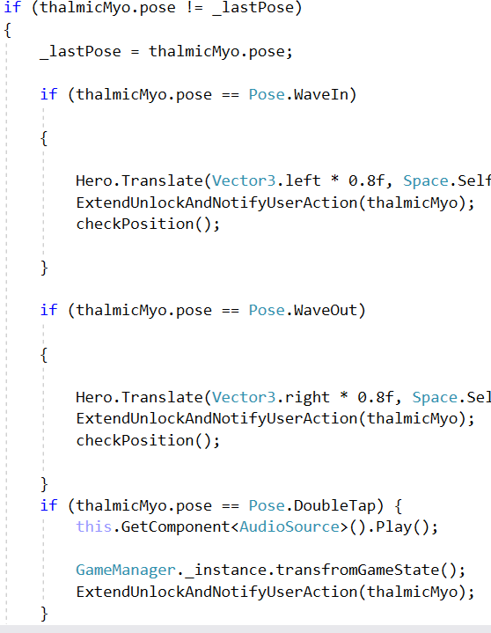
Gesture control

Slide 5
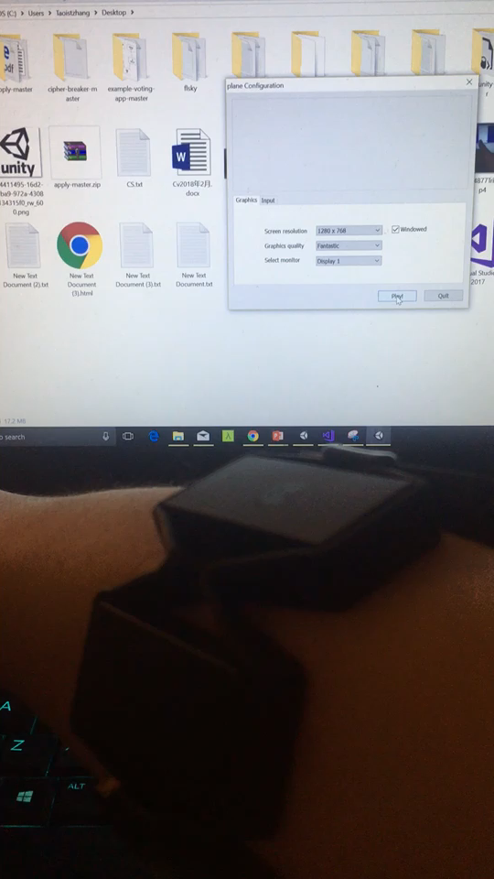
DEMO

